Slide 1
How to Have Your Causality and Wall Clocks, Too
Jon Moore
Senior Fellow, Comcast Cable
@jon_moore

Slide 2
Server A
[25/Sep/2015:10:10:23 -0500] "GET / HTTP/1.1" 200
Server B
[25/Sep/2015:10:10:29 -0500] "GET / HTTP/1.1" 200

Slide 3
Server A
[25/Sep/2015:10:10:23 -0500] "GET / HTTP/1.1" 200
10:10:23
Server B
[25/Sep/2015:10:10:29 -0500] "GET / HTTP/1.1" 200
10:10:29

Slide 4
10:10:23
10:10:23
10:10:29
10:10:29

Slide 5
that
10:10:23
totally
happened
before
10:10:29
this

Slide 6
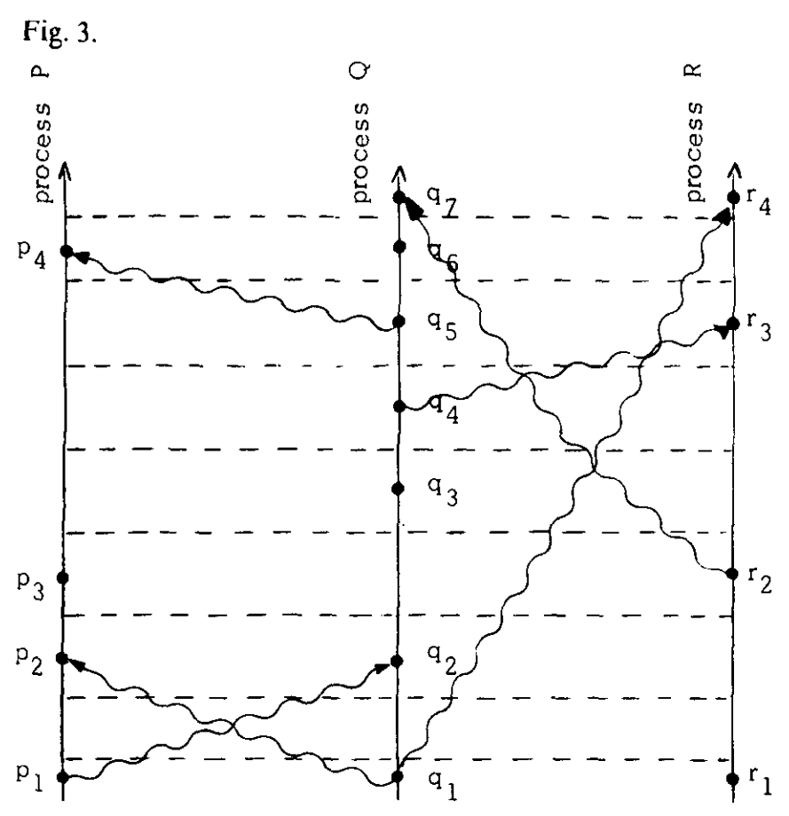
p₁ → r₃
Lamport, L. Time, clocks, and the ordering of events in a distributed system. Communications of the ACM, 21:7, July 1978, pp. 558-565.

Slide 7
p₁ → r₃
Lamport, L. Time, clocks, and the ordering of events in a distributed system. Communications of the ACM, 21:7, July 1978, pp. 558-565.

Slide 8
p₁ → r₃
Lamport, L. Time, clocks, and the ordering of events in a distributed system. Communications of the ACM, 21:7, July 1978, pp. 558-565.

Slide 9
p₁ → r₃
5
4
1 < 5
3
2
1
Lamport, L. Time, clocks, and the ordering of events in a distributed system. Communications of the ACM, 21:7, July 1978, pp. 558-565.

Slide 10
p₁ → r₃
5
4
1 < 5
3
2
1
Lamport, L. Time, clocks, and the ordering of events in a distributed system. Communications of the ACM, 21:7, July 1978, pp. 558-565.

Slide 11
p₁ → r₃
5
4
1 < 5
3
2
1
Lamport, L. Time, clocks, and the ordering of events in a distributed system. Communications of the ACM, 21:7, July 1978, pp. 558-565.
Notes:
Make point that Lamport clocks are piggybacked on other application message exchanges

Slide 12
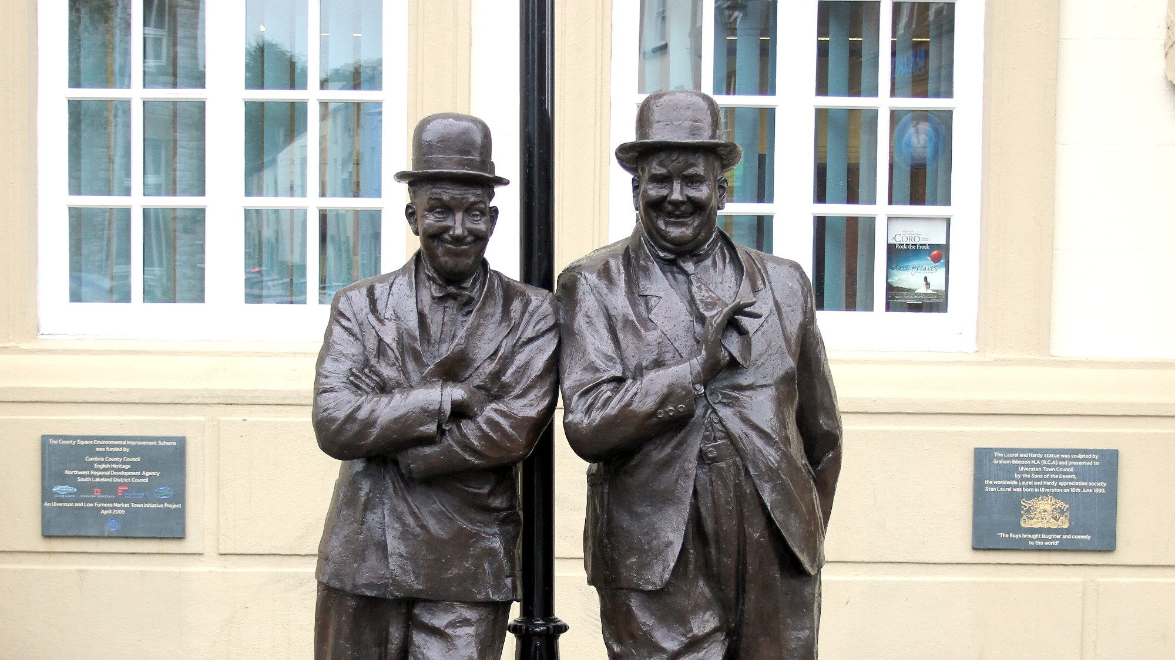
Did you hear about the error
that happened at time 42?
Was that in UTC?
Photo: Hilton Teper, CC BY-SA 3.0

Slide 13
3:11pm
7
Kulkarni, S. et al. Logical physical clocks and consistent snapshots in globally distributed databases. TR 2014-04, Dept. of Computer Science and Engineering, University at Buffalo, SUNY, Buffalo, NY, USA, May 2014.

Slide 14
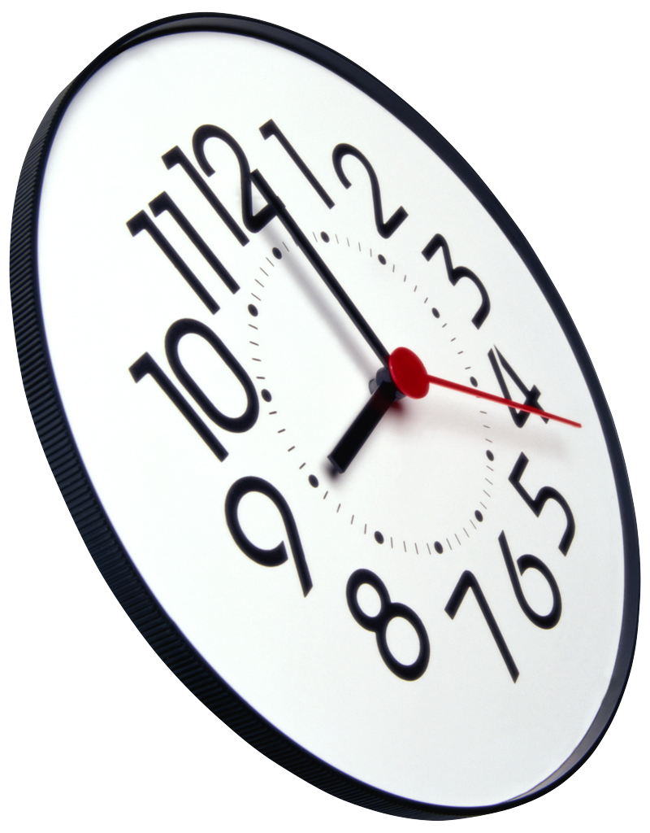
3:13pm
0
3:13pm
3:11pm
7
Kulkarni, S. et al. Logical physical clocks and consistent snapshots in globally distributed databases. TR 2014-04, Dept. of Computer Science and Engineering, University at Buffalo, SUNY, Buffalo, NY, USA, May 2014.

Slide 15
3:11pm
8
3:09pm
3:11pm
7
Kulkarni, S. et al. Logical physical clocks and consistent snapshots in globally distributed databases. TR 2014-04, Dept. of Computer Science and Engineering, University at Buffalo, SUNY, Buffalo, NY, USA, May 2014.

Slide 16
3:13pm
0
3:09pm
3
3:13pm
3:11pm
7
Kulkarni, S. et al. Logical physical clocks and consistent snapshots in globally distributed databases. TR 2014-04, Dept. of Computer Science and Engineering, University at Buffalo, SUNY, Buffalo, NY, USA, May 2014.

Slide 17
3:11pm
8
3:09pm
3
3:08pm
3:11pm
7
Kulkarni, S. et al. Logical physical clocks and consistent snapshots in globally distributed databases. TR 2014-04, Dept. of Computer Science and Engineering, University at Buffalo, SUNY, Buffalo, NY, USA, May 2014.

Slide 18
3:15pm
4
3:15pm
3
3:13pm
3:11pm
7
Kulkarni, S. et al. Logical physical clocks and consistent snapshots in globally distributed databases. TR 2014-04, Dept. of Computer Science and Engineering, University at Buffalo, SUNY, Buffalo, NY, USA, May 2014.

Slide 19
3:11pm
8
3:11pm
3
3:09pm
3:11pm
7
Kulkarni, S. et al. Logical physical clocks and consistent snapshots in globally distributed databases. TR 2014-04, Dept. of Computer Science and Engineering, University at Buffalo, SUNY, Buffalo, NY, USA, May 2014.

Slide 20
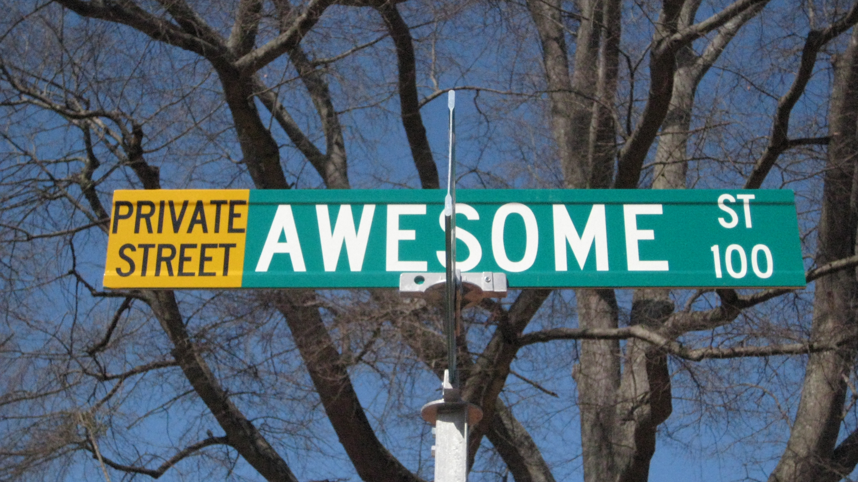
Photo adapted from: https://www.flickr.com/photos/moonlightbulb/3338852116/
CC BY 2.0: https://creativecommons.org/licenses/by/2.0/

Slide 21
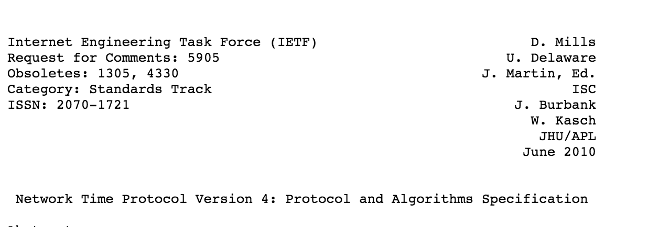

Slide 22
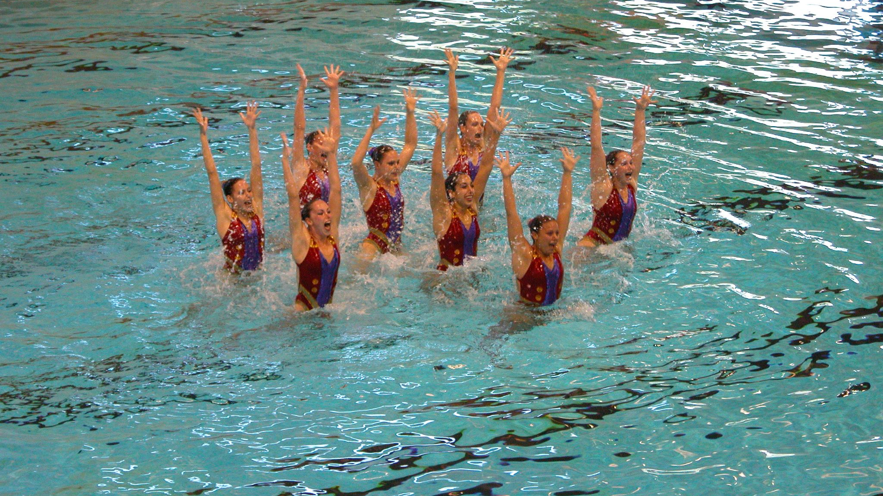
Adapted from: https://www.flickr.com/photos/krhamm/171302038
CC BY-SA 2.0: https://creativecommons.org/licenses/by-sa/2.0/

Slide 23
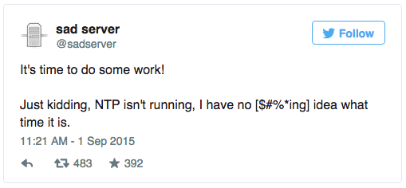

Slide 25
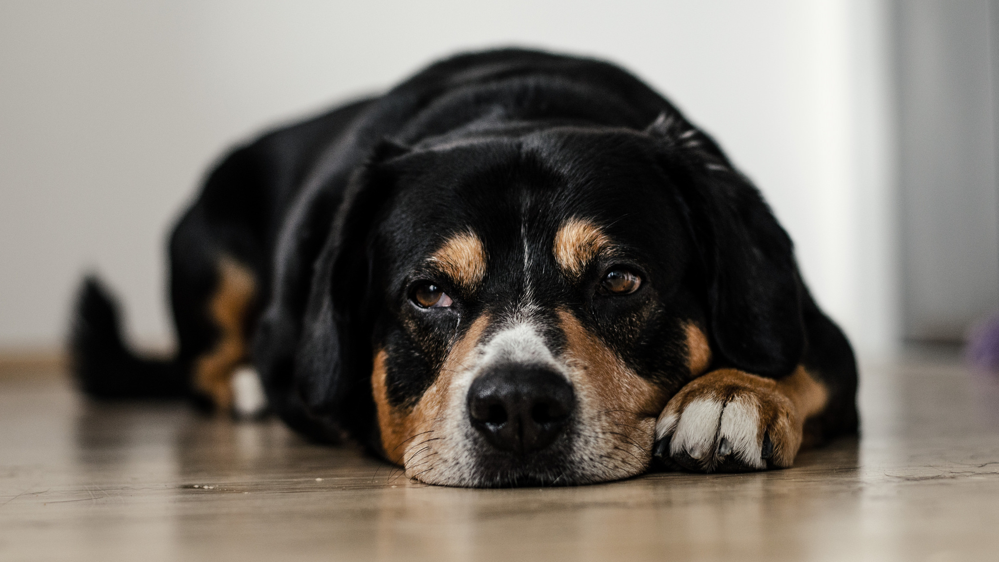
Adapted from: https://www.flickr.com/photos/100068961@N08/15414184486/
CC BY 2.0: https://creativecommons.org/licenses/by/2.0/
Notes:
Ntpd gave up

Slide 26
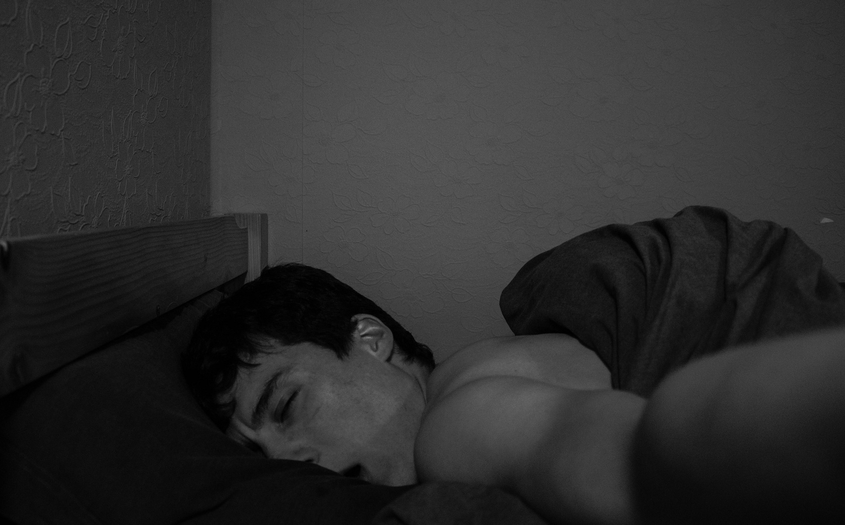
Adapted from: https://www.flickr.com/photos/128475663@N06/16042690222/
CC BY 2.0: https://creativecommons.org/licenses/by/2.0/

Slide 27
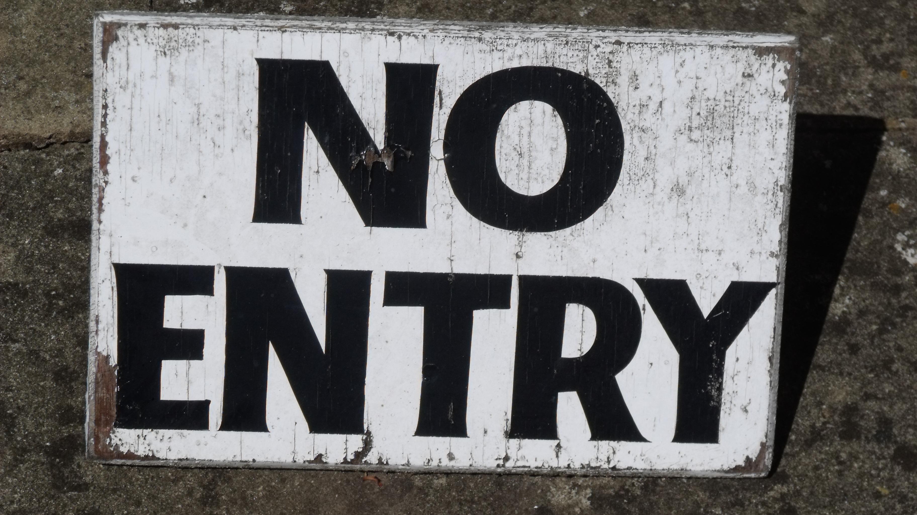
Adapted from: https://www.flickr.com/photos/ell-r-brown/4653934654/
CC BY 2.0: https://creativecommons.org/licenses/by/2.0/
Notes:
NTP blocked

Slide 28
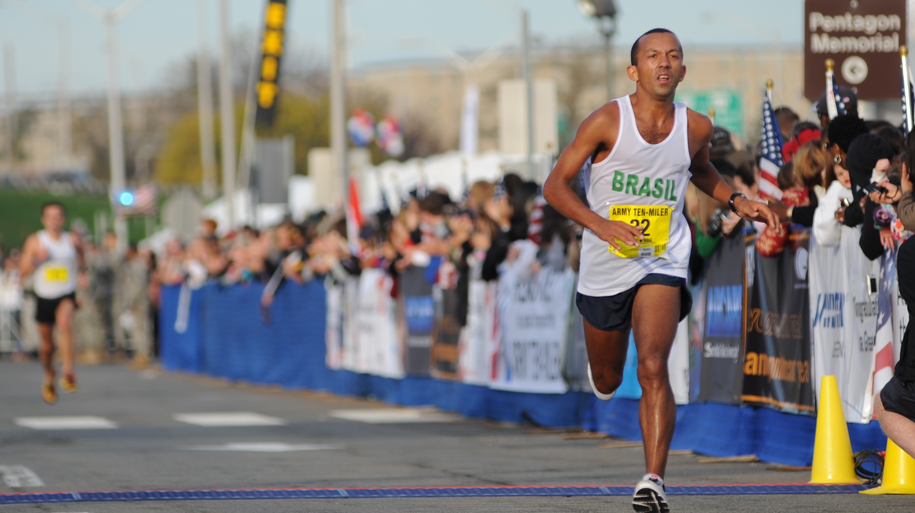
Adapted from: https://www.flickr.com/photos/familymwr/5112955442/
CC BY 2.0: https://creativecommons.org/licenses/by/2.0/

Slide 29
25/Sep/2015:10:10:23 -0500
7

Slide 30
25/Sep/2015:10:10:23 -0500
7

Slide 31
25/Sep/2051:10:10:23 -0500
7

Slide 32
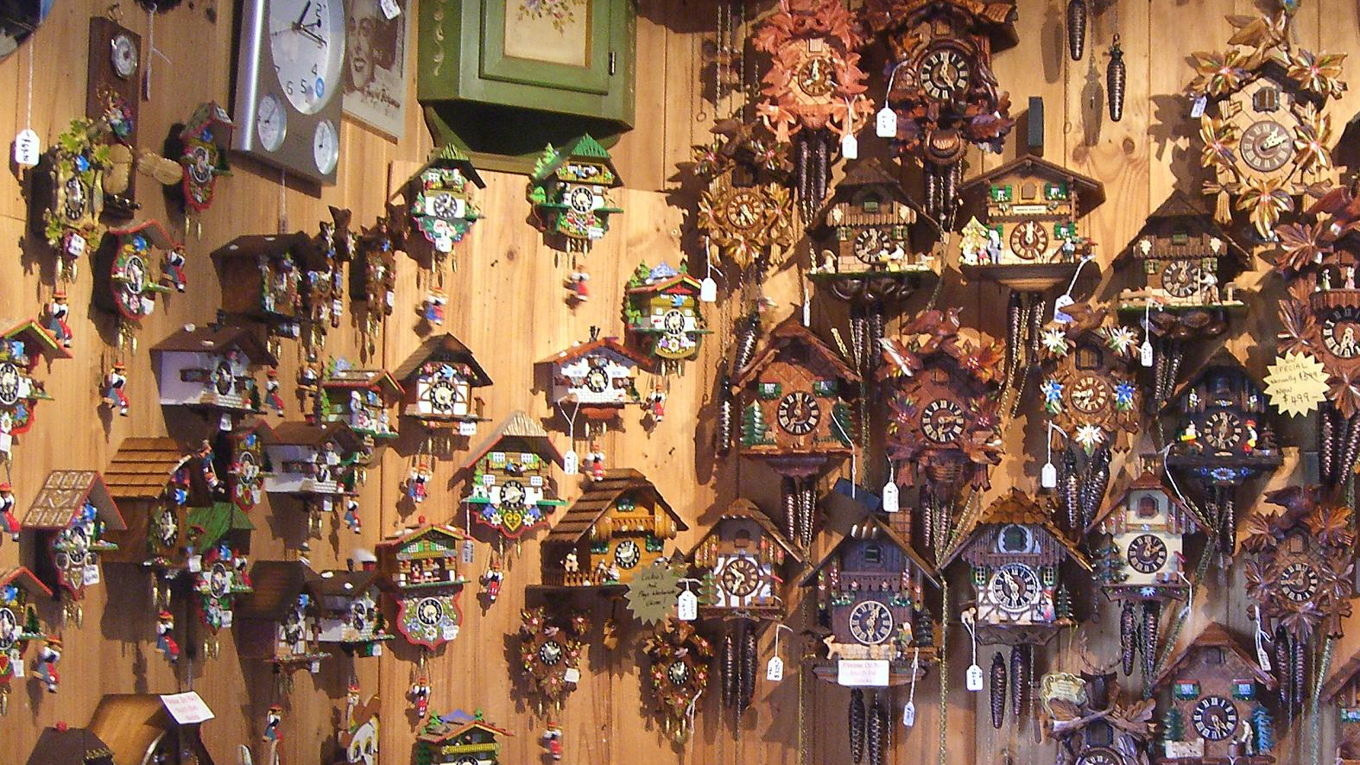
Distributed
Monotonic
Clocks!
Photo adapted from: https://www.flickr.com/photos/avlxyz/2580021434/
CC BY-SA 2.0: https://creativecommons.org/licenses/by-sa/2.0/

Slide 33
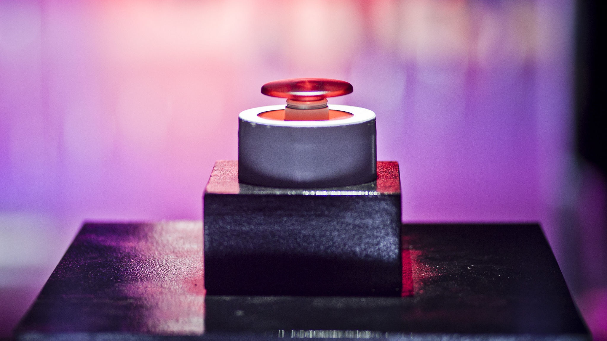
Adapted from: https://www.flickr.com/photos/c2mtl/7250373436/
CC BY 2.0: https://creativecommons.org/licenses/by/2.0/
Notes:
Reset button

Slide 34
epoch
1
3:11pm
7

Slide 35
2
3:09pm
0
Reset!
+
3:09pm
1
8:11pm
7

Slide 36
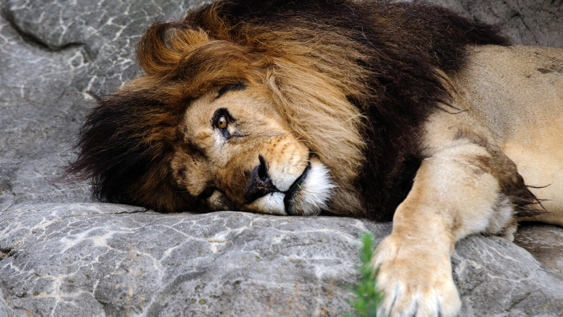
Adapted from: https://www.flickr.com/photos/ekilby/5867966900/
CC BY-SA 2.0: https://creativecommons.org/licenses/by-sa/2.0/

Slide 37
3:11pm
8
3:09pm
3
8:13pm
I’m too far ahead!!!
3:11pm
7

Slide 38
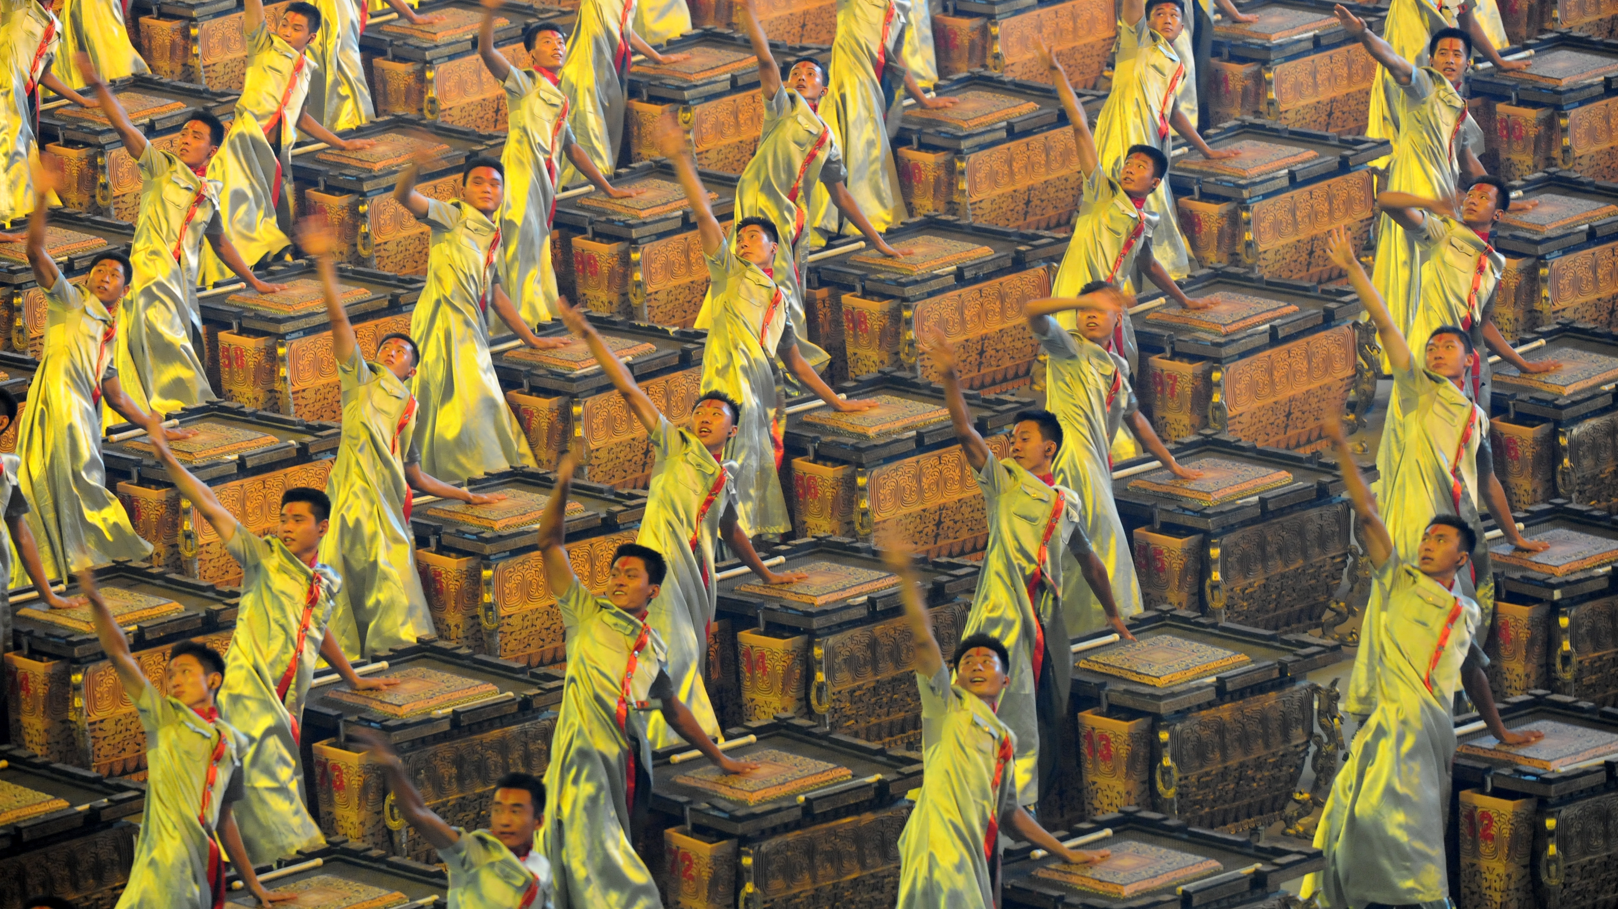
Adapted from: https://www.flickr.com/photos/familymwr/4928484952/
CC BY 2.0: https://creativecommons.org/licenses/by/2.0/

Slide 39
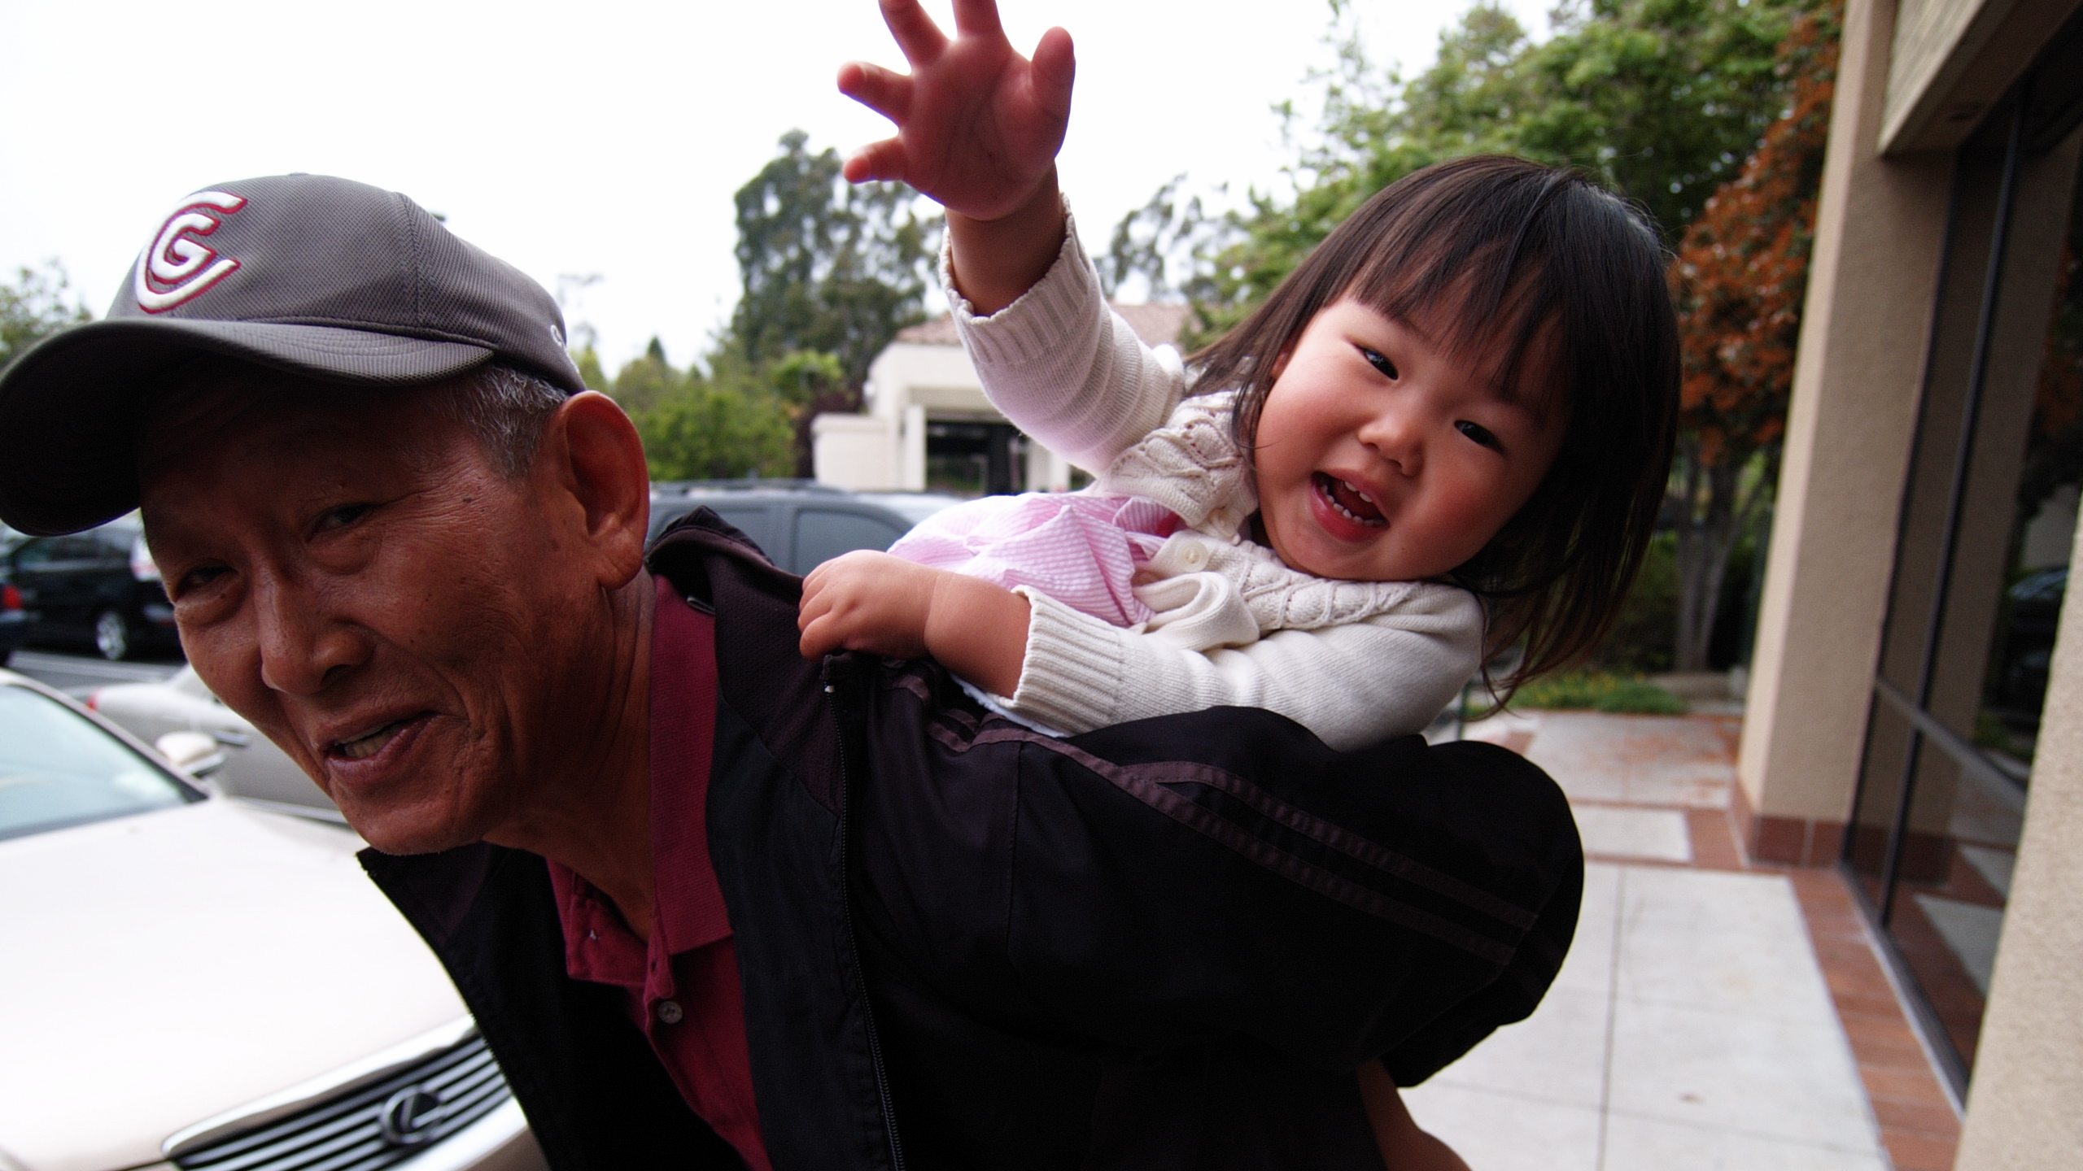
Adapted from: https://www.flickr.com/photos/mliu92/3520082663/
CC BY-SA 2.0: https://creativecommons.org/licenses/by-sa/2.0/

Slide 40
byte[] now();
void receive(byte[] dmcTimestamp);

Slide 41
byte[] now();
void receive(byte[] dmcTimestamp);

Slide 42
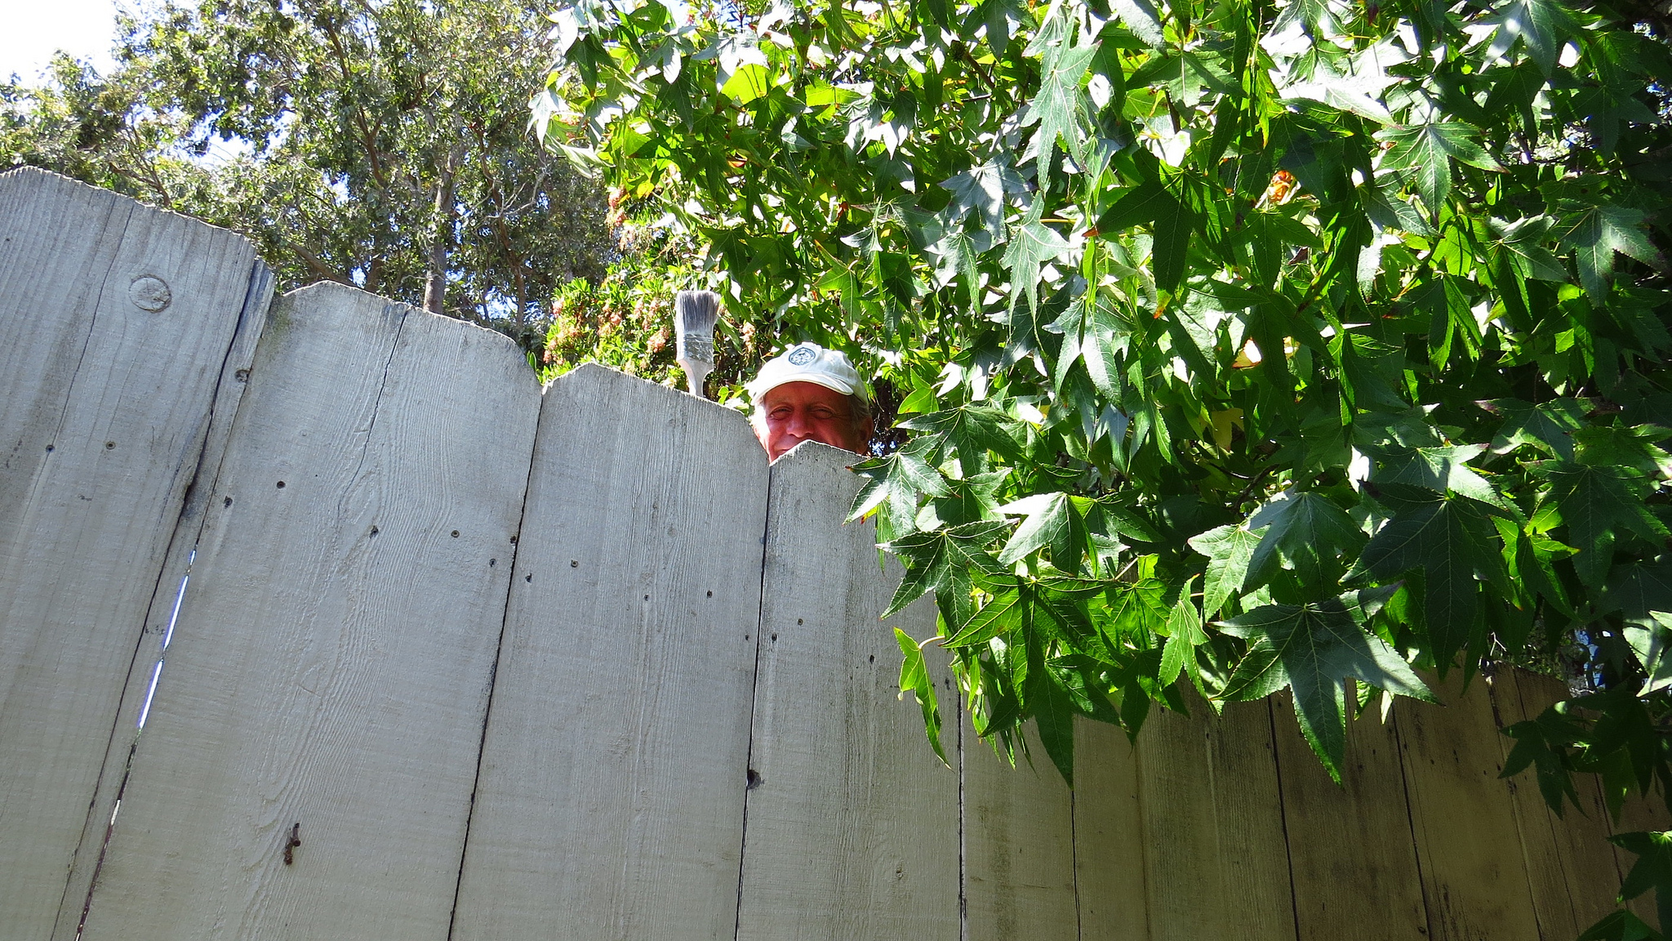
Adapted from: https://www.flickr.com/photos/minicooper93402/14491419068/
CC BY 2.0: https://creativecommons.org/licenses/by/2.0/

Slide 43
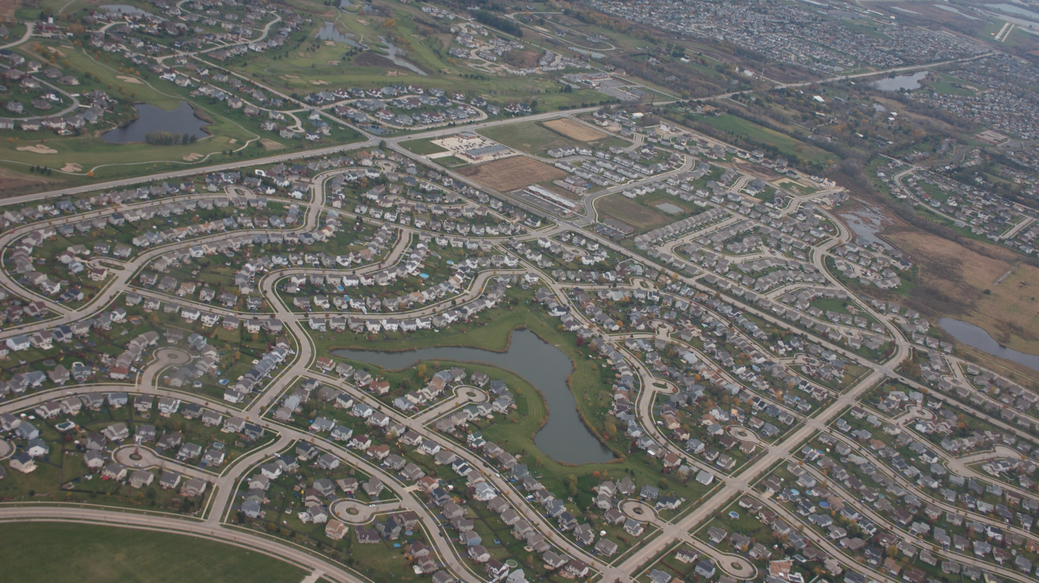
Adapted from: https://www.flickr.com/photos/mike_miley/2997001748/
CC BY-SA 2.0: https://creativecommons.org/licenses/by-sa/2.0/

Slide 44
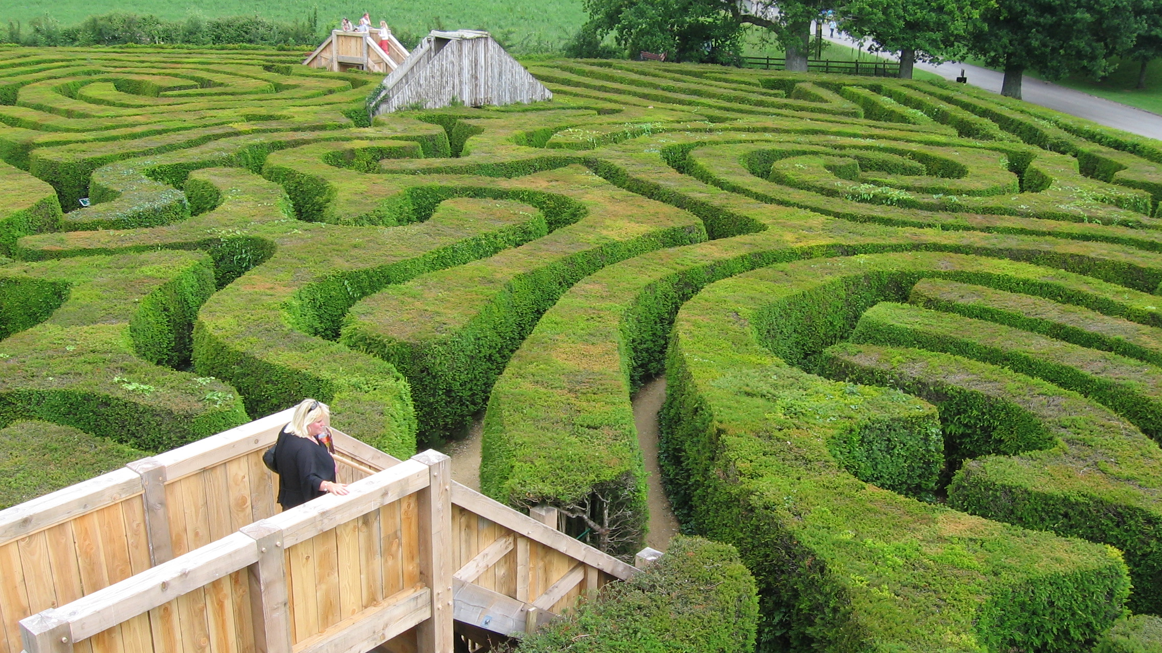
Adapted from: https://www.flickr.com/photos/10746069@N08/942031605/
CC BY 2.0: https://creativecommons.org/licenses/by/2.0/

Slide 45
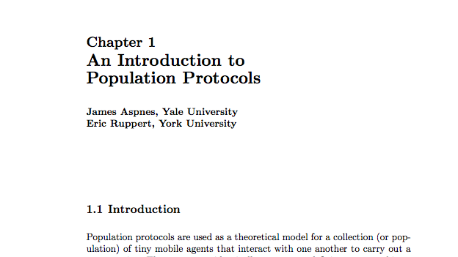

Slide 46
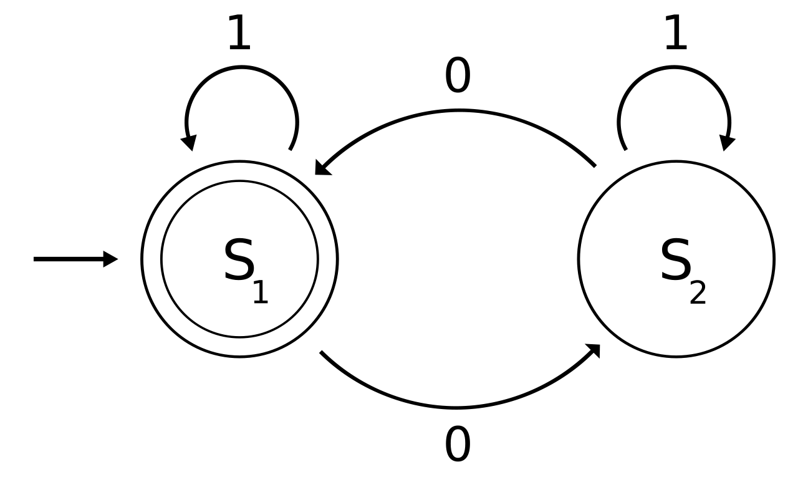
Image source: https://en.wikipedia.org/wiki/File:DFAexample.svg. Public domain.

Slide 47
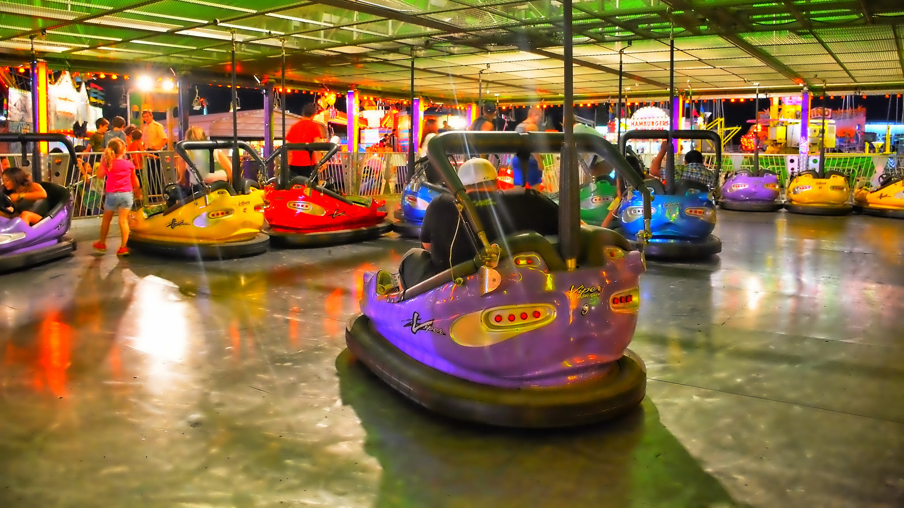
Adapted from: https://www.flickr.com/photos/27190564@N02/15186053421/
CC BY-SA 2.0: https://creativecommons.org/licenses/by-sa/2.0/

Slide 48
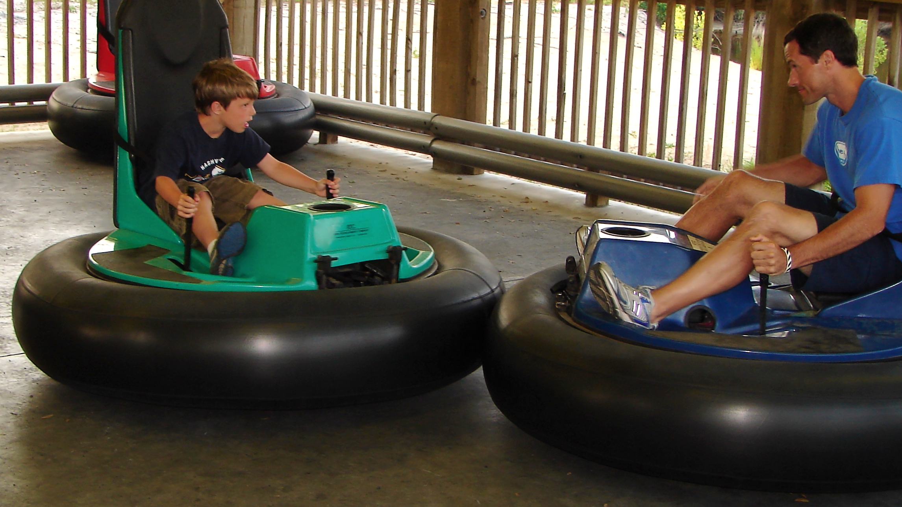
Adapted from: https://www.flickr.com/photos/barretthall/4696766252/
CC BY 2.0: https://creativecommons.org/licenses/by/2.0/

Slide 49
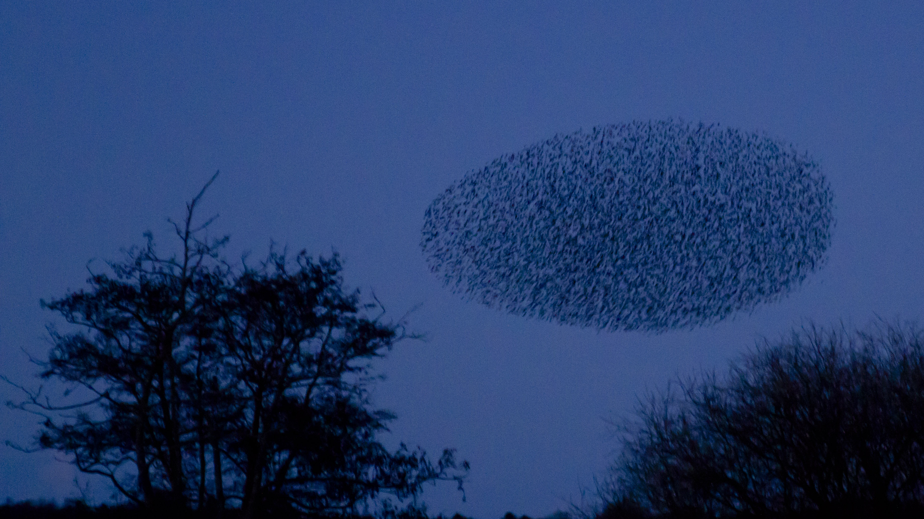
Adapted from: https://www.flickr.com/photos/27770620@N02/6781835682/
CC BY-SA 2.0: https://creativecommons.org/licenses/by-sa/2.0/

Slide 50
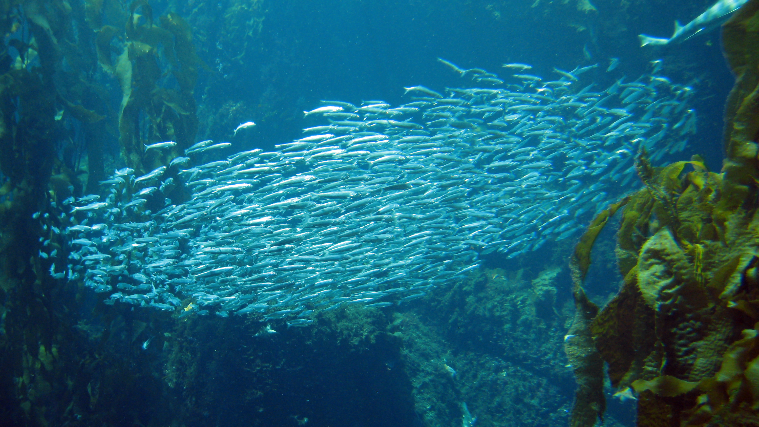
Adapted from: https://www.flickr.com/photos/tyrian123/479201720/
CC BY 2.0: https://creativecommons.org/licenses/by/2.0/

Slide 51
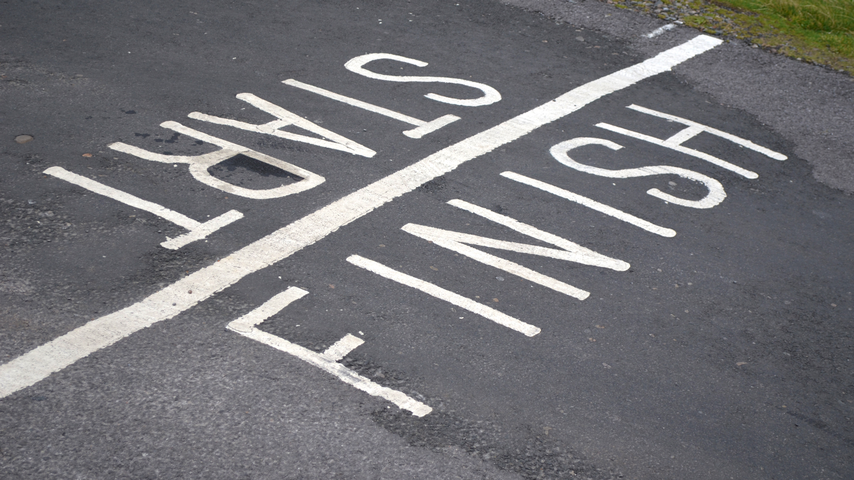
Adapted from: https://www.flickr.com/photos/andrewhurley/6254409229/
CC BY-SA 2.0: https://creativecommons.org/licenses/by-sa/2.0/

Slide 52
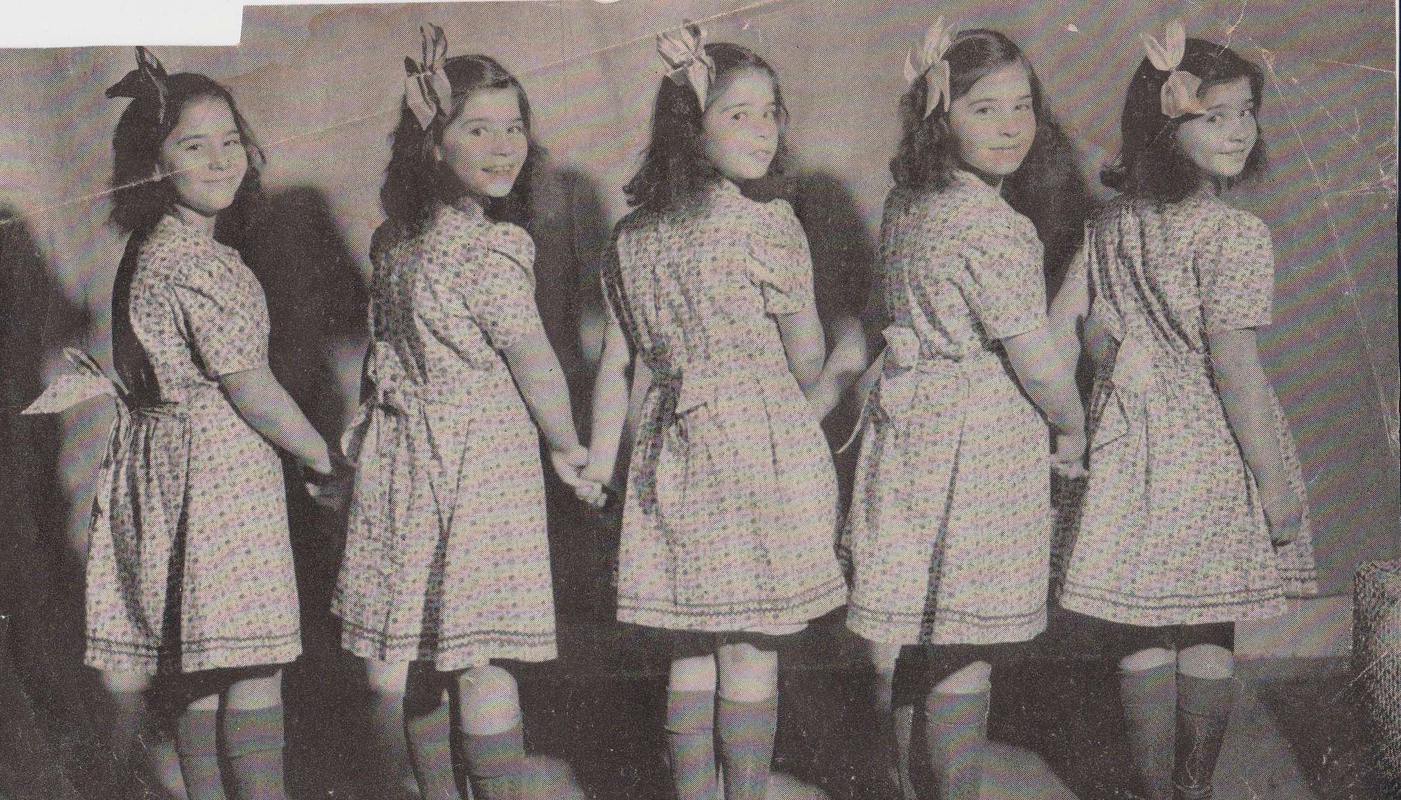
Source: https://www.flickr.com/photos/daniandgeorge/16959908831/. Public Domain.

Slide 53
not ok
ok
median clock
Adapted from: https://www.flickr.com/photos/27770620@N02/6781835682/
CC BY-SA 2.0: https://creativecommons.org/licenses/by-sa/2.0/

Slide 56
degree = 4
degree = 3
degree = 5

Slide 57
degree = 4
degree = 3
degree = 5

Slide 72
O(log n)

Slide 74
O(log n)

Slide 81
1
3
-1
0
Offset to median = 1
2

Slide 82
Offset to median = -2
-2
0
-4
-3
Offset to median = 1
-1

Slide 84
3:11pm
8
3:09pm
3
8:13pm
I’m too far ahead!!!
3:11pm
7

Slide 85
3:11pm
8
3:09pm
3
I have no clock!!!
3:11pm
7

Slide 86
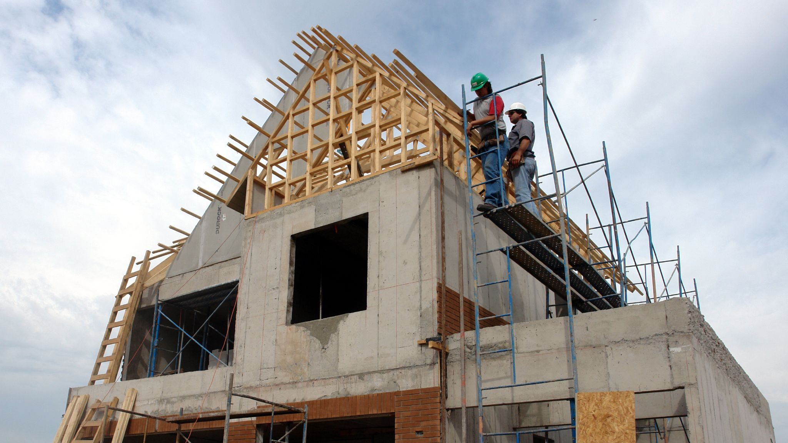
Adapted from: https://www.flickr.com/photos/concrete_forms/523765240/
CC BY 2.0: https://creativecommons.org/licenses/by/2.0/

Slide 87
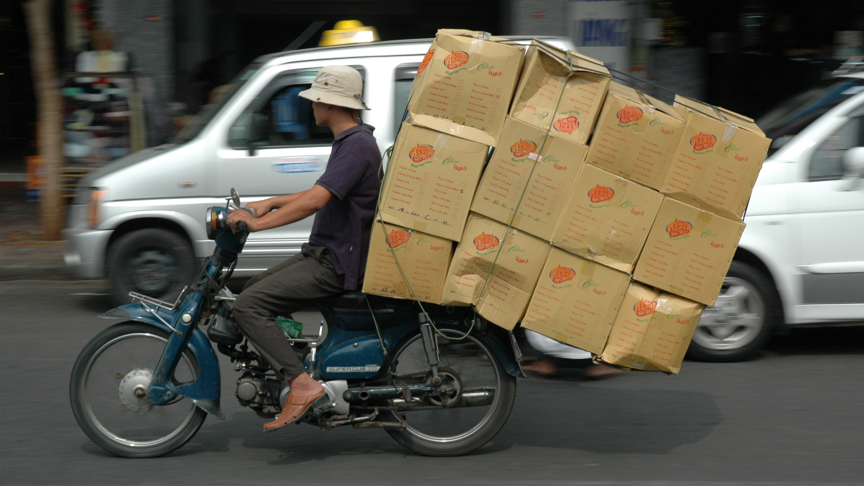
Adapted from: https://www.flickr.com/photos/graemenewcomb/358329131/
CC BY 2.0: https://creativecommons.org/licenses/by/2.0/

Slide 88
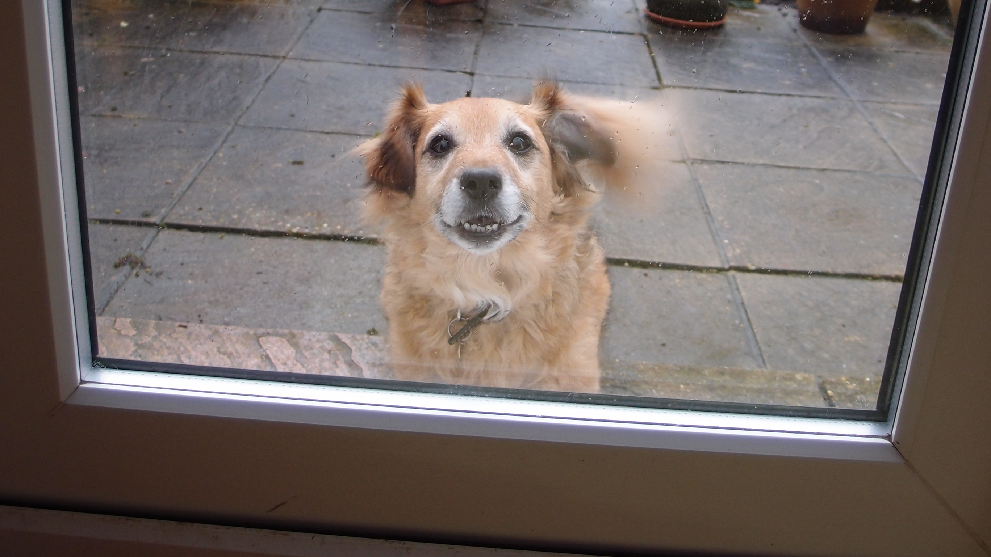
Adapted from: https://www.flickr.com/photos/superba_/8304175110/
CC BY 2.0: https://creativecommons.org/licenses/by/2.0/

Slide 89
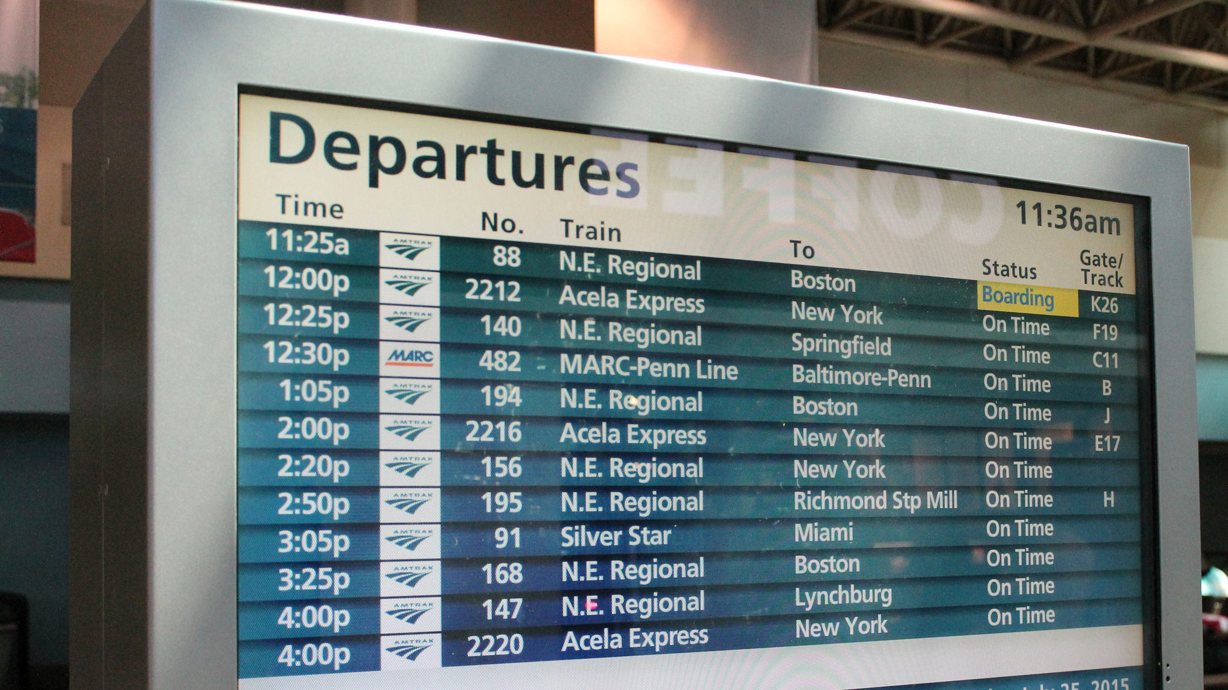
Adapted from: https://www.flickr.com/photos/perspective/19406633864/
CC BY-SA 2.0: https://creativecommons.org/licenses/by-sa/2.0/

Slide 90
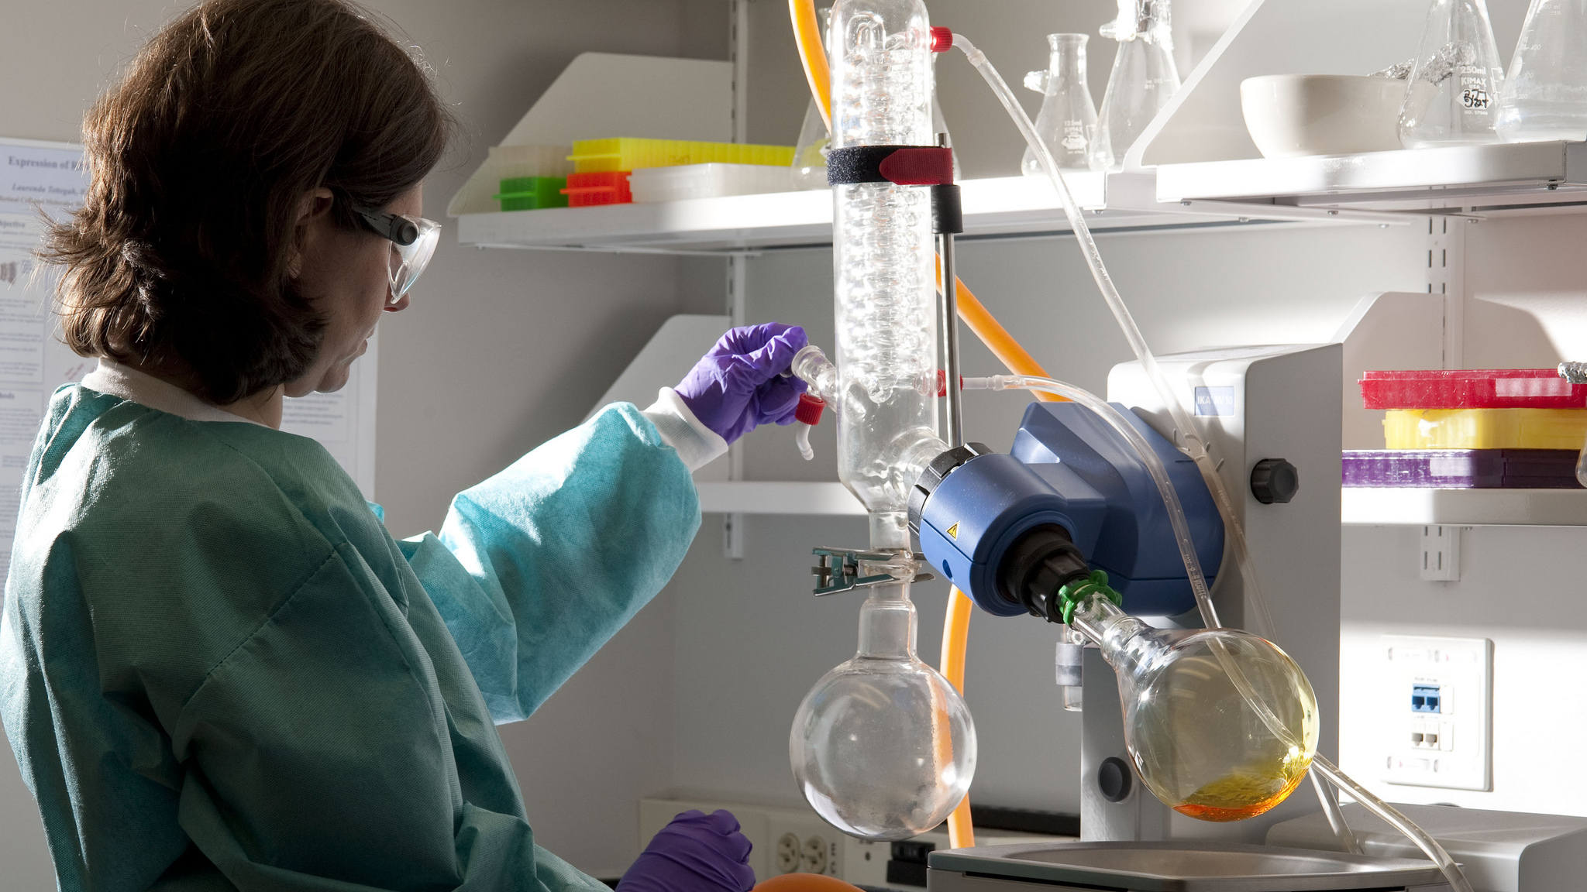
Adapted from: https://www.flickr.com/photos/nationaleyeinstitute/9955408003/
CC BY 2.0: https://creativecommons.org/licenses/by/2.0/

Slide 91
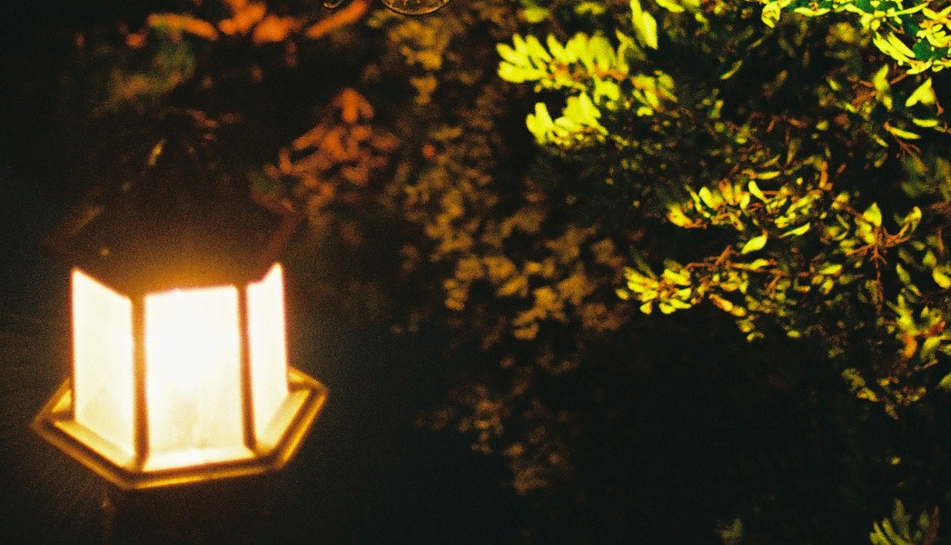
Adapted from: https://www.flickr.com/photos/cobacco/3340218343/
CC BY 2.0: https://creativecommons.org/licenses/by/2.0/

Slide 92
How to Have your Causality and Wall Clocks, Too
Distributed Monotonic Clocks (DMC)
Reflect causality and can track human time too
Operational reset buttons needed!
Population protocol “flocking” to avoid resets
Accommodates (some) clockless nodes
More work needed (and coming!)
Jon Moore (@jon_moore)

